Slide 1
Free Covid
Free Covid is a web application that allows users a way to get there Covid vaccinations

Slide 2
Utilisations
Once on the Home page user’s are provided with simple interface giving them a first look at what the site has to offer.
Such as
Hospitals in his/her area
Make an appointment
General Stats on the Epidemic in the country

Slide 3
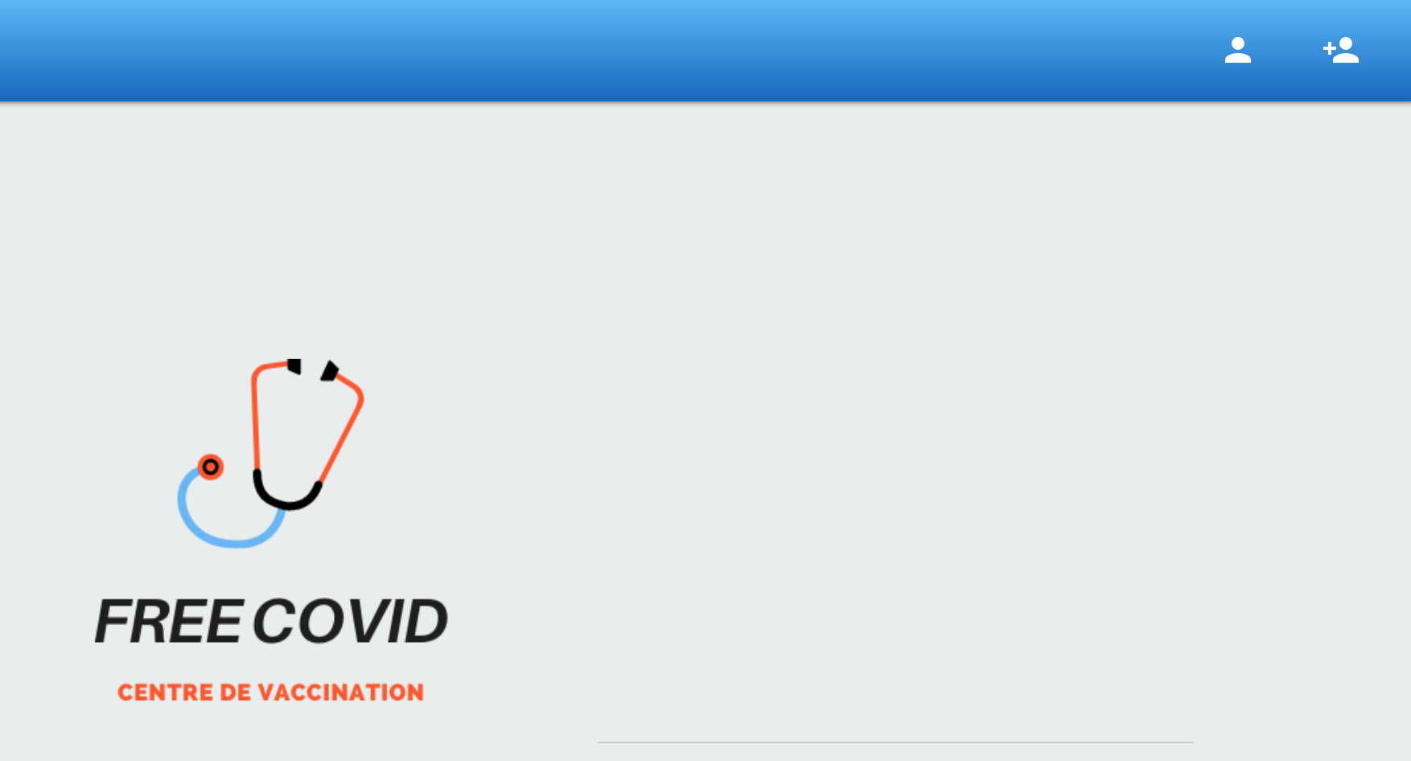
How to Login or Register
Click Here

Slide 4
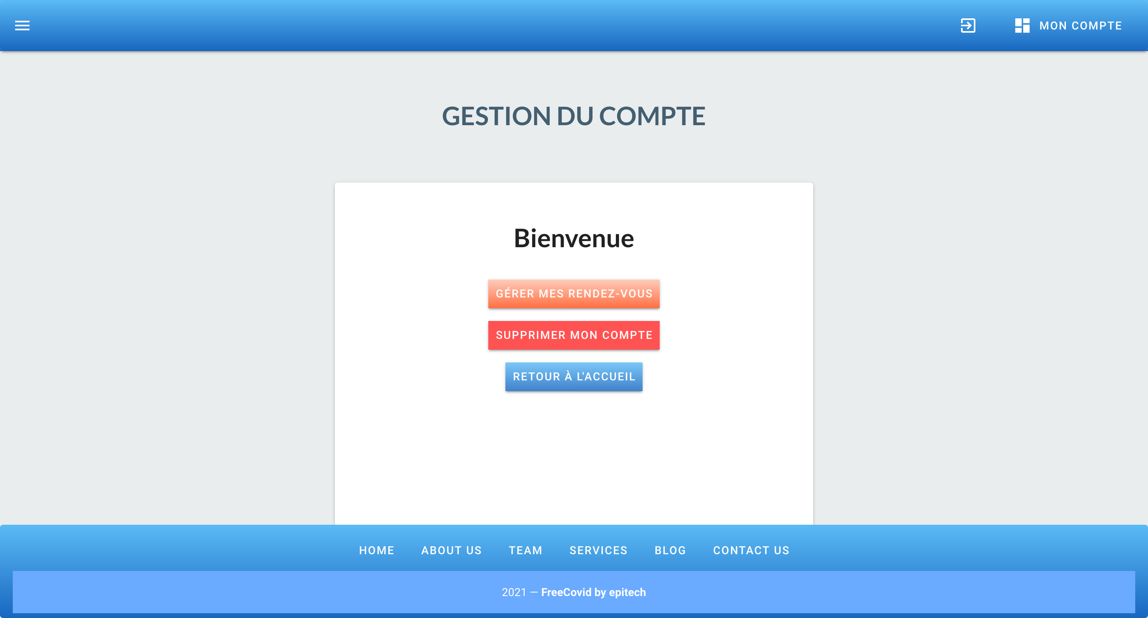
Connected
Now that you are connected you have three options
Make an appointment
Delete your account
Return to Home
Next we will make an appointment

Slide 5
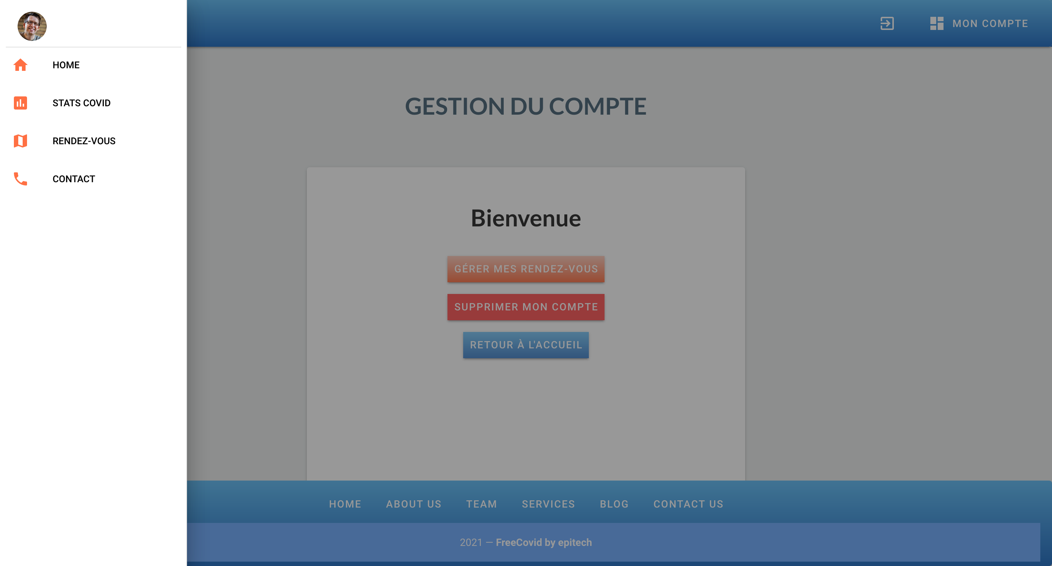
Making an Appointment
First open the Nav Bar in the top left corner of the screen
Click on ‘Rendez-Vous’
Allow current localisation
Select the Hospital or Clinique of your choice
Choose the date and time you would like to get vaccinated.

Slide 6
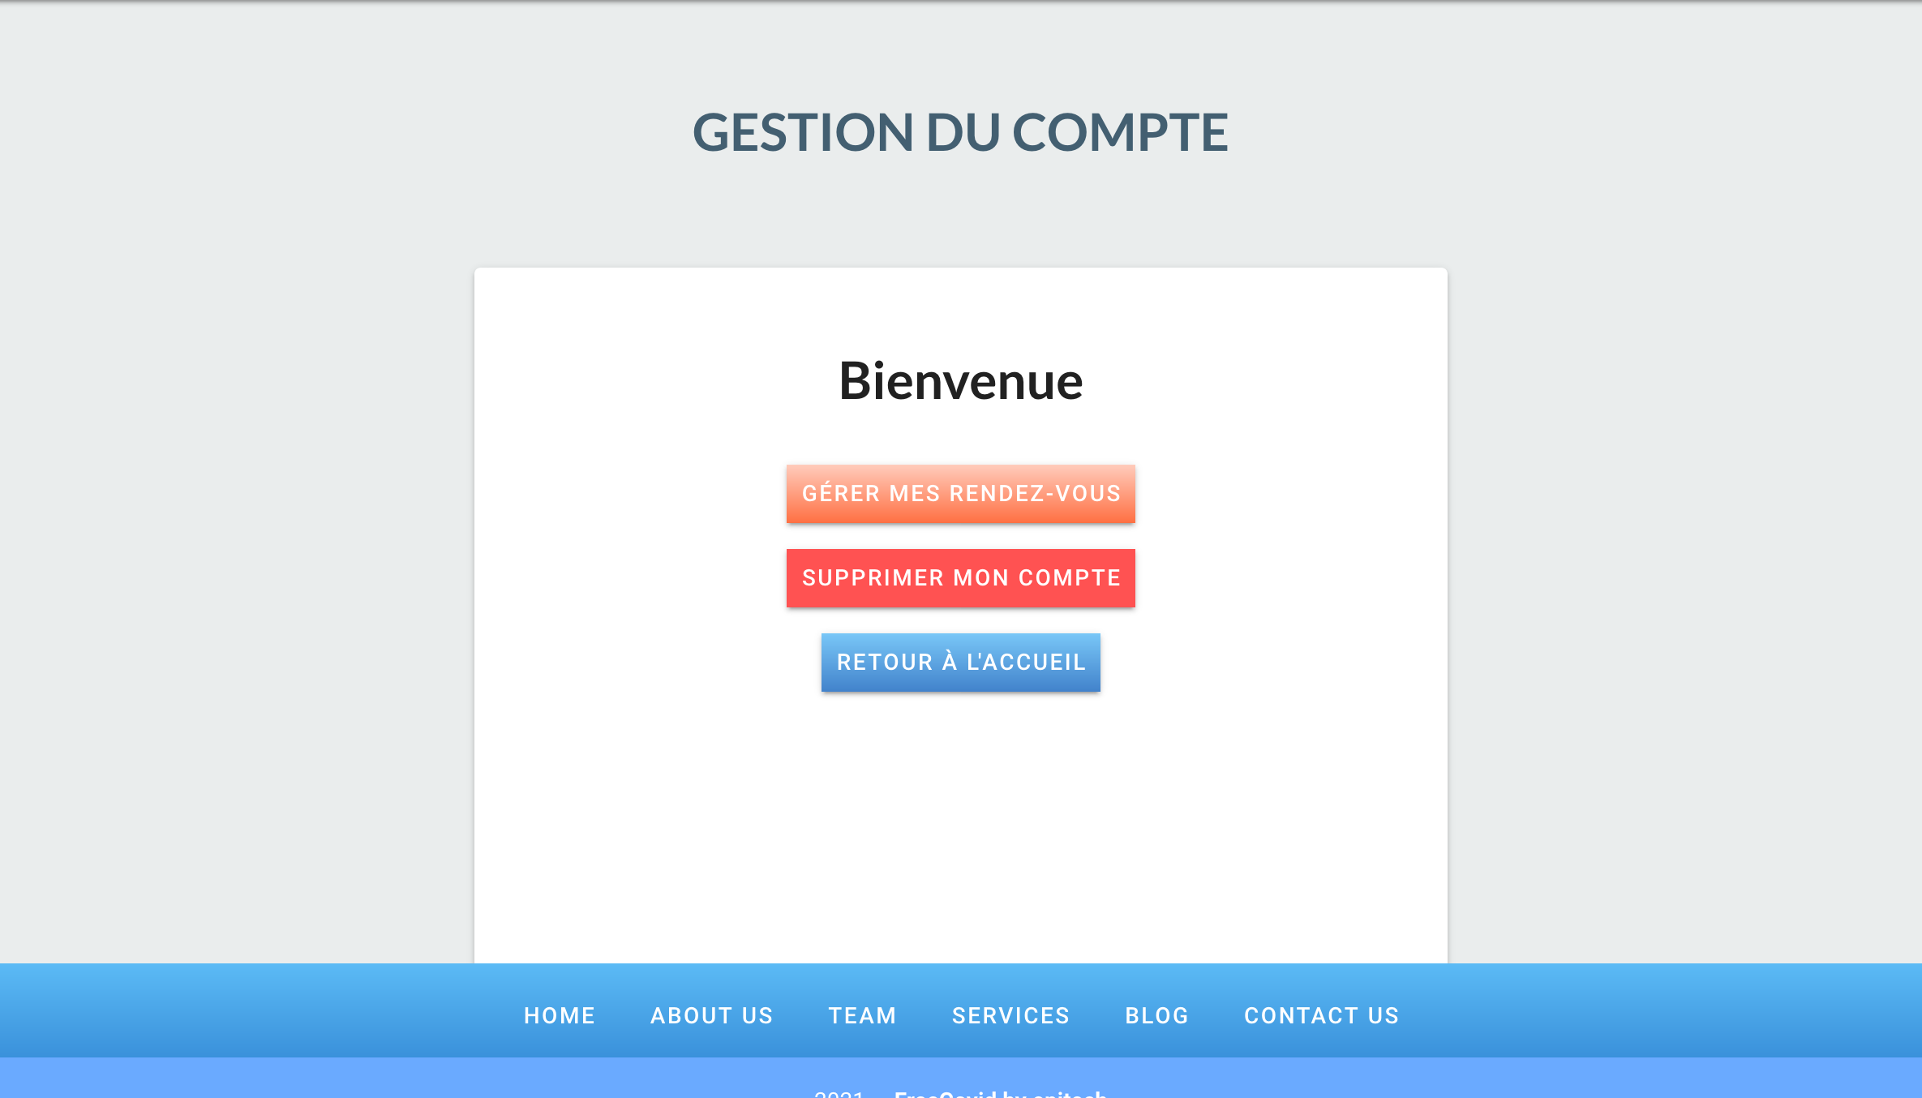
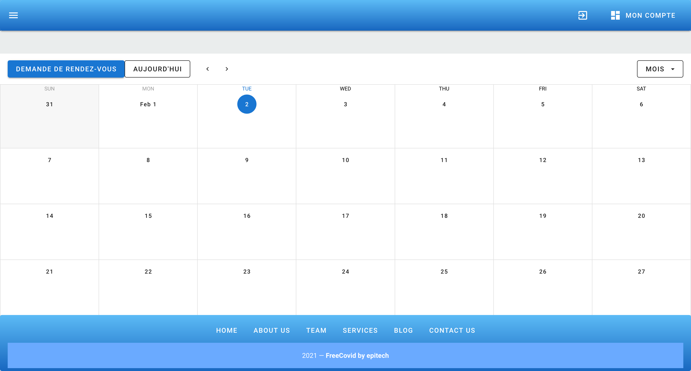
Managing Appointments
Go to your account and select ‘Gerer mes Rendez-vous
Select the RDV you want to change or Create a new one by clicking ‘Demande de Rendez-Vous

